Slide 1
Bioinformatics Nanocourse:
Gene Regulation with RNA-seq

Slide 2
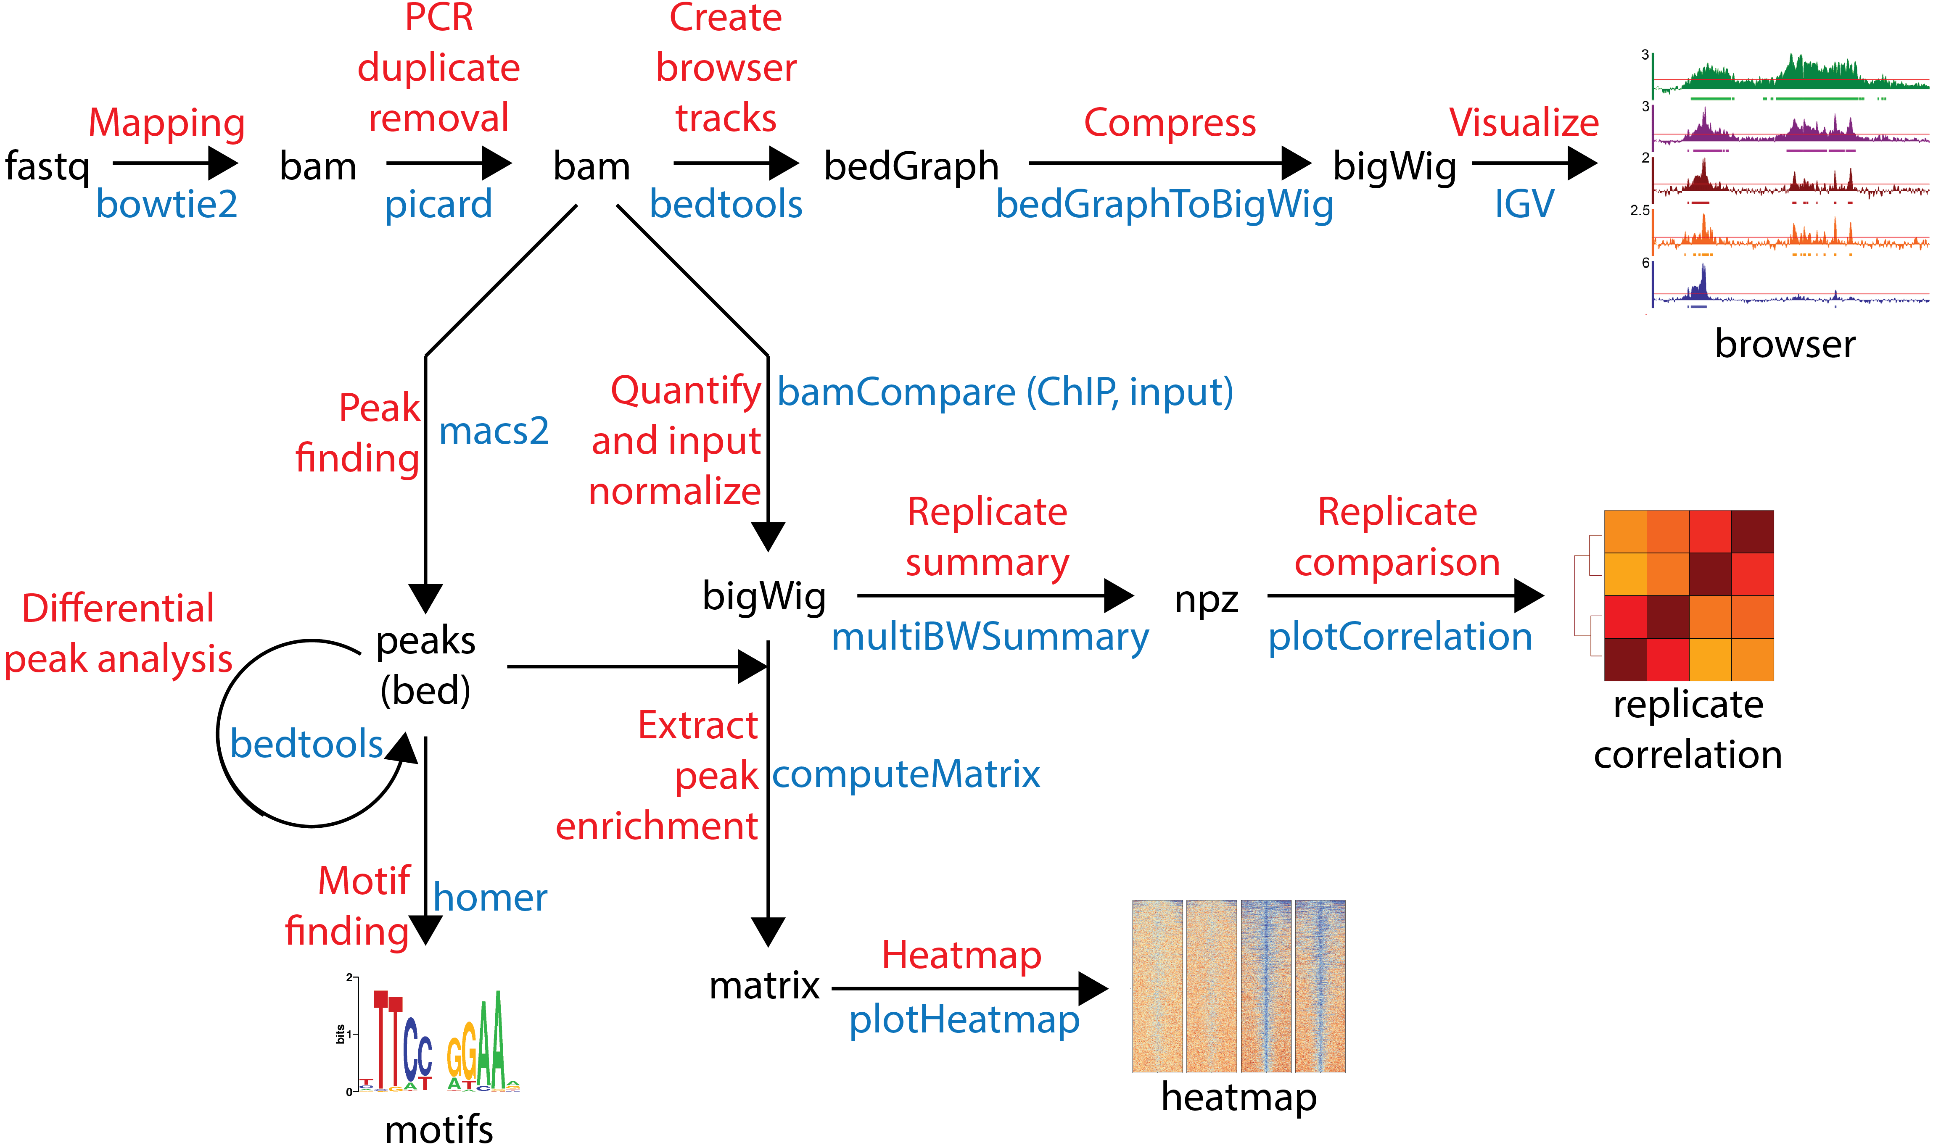
Goals
Process raw RNA-seq data
Visualize data
Perform differential analysis
Make heatmaps and venndiagrams using R

Slide 3
Class overview
Morning
RNA experiments
Genome Annotations
Mapping ( +QC)
Visualization (+QC)
Quantification
Afternoon
Intro To R
Correlation
Differential analysis
Figure making

Slide 4
Overview
4
5
1
PCR
duplicate removal
Create
Browser
tracks
6
Mapping
Visualize
fastq
bam
bam
bigwig
hisat2
picard
deeptools
IGV
3
Annotations
(gtf)
2
Mapping Quality
fastqc
Sequence Quality
7
featureCounts
Fastqc
Report
Alignment
Stats
Quantification
9
Differential Analysis
Differential
Expressed
Genes
RNA reports
csv
deSeq2
8
multiqc
QC
report
html

Slide 5
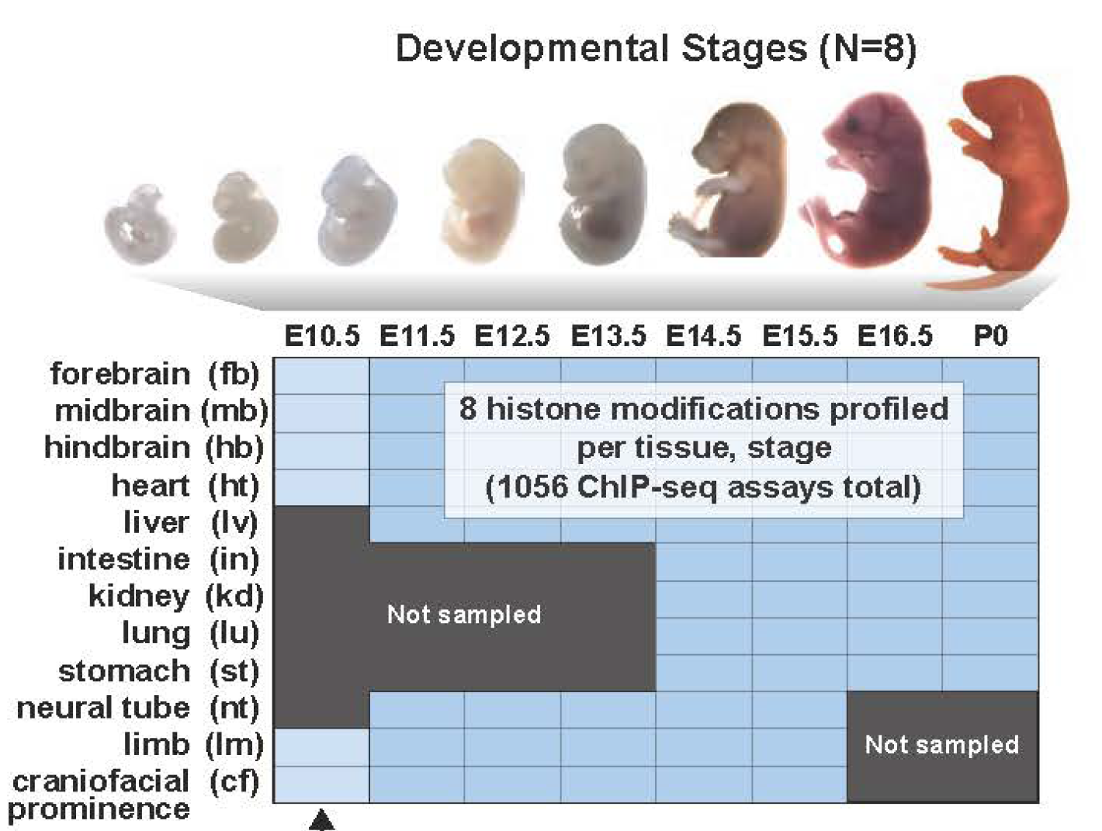
Case Study: Heart Development
ENCODE Project
An atlas of dynamic chromatin landscapes in mouse fetal development. Nature 2020
Heart: e11.5 vs P0
H3K27ac and input
2 biological replicates

Slide 6
Case Study: Questions we’ll answer
Did the experiment work (technically)?
Does it map?
Where is RNA signal?
How does Expression change during heart development?

Slide 7
Overview of Morning
4
5
2
PCR
duplicate removal
Create
Browser
tracks
6
Mapping
Visualize
fastq
bam
bam
bigwig
hisat2
picard
deeptools
IGV
3
1
Mapping Quality
fastqc
Sequence Quality
Overview of RNA-seq
Genome Annotations
Coordinate Systems
Introduction to File Formats
Explore GTF File
Fastqc
Report
Alignment
Stats
RNA reports

Slide 8
RNA gives information on which genes are expressed
How DNA is transcribed to RNA (and sometimes then translated to proteins) varies between e.g.
Tissues
Cell Types
Cell States
Individuals

Slide 9
One gene many different isoforms

Slide 10
RNA Flavors
House keeping RNA’s
rRNs, tRNAs, snoRNAs, snRNAs, SRP RNAs catalytic RNAs (RNAse E)
Protein coding RNA’s
(1 coding gene ~~ 1 mRNA)
Regulatory RNAs
Few rare examples

Slide 11
Overview of RNA-seq

Slide 12
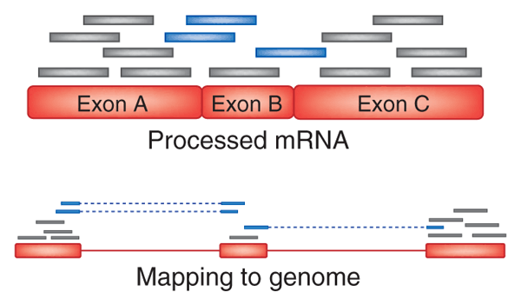
Alignment to Genome and Reference Annotations
https://genomebiology.biomedcentral.com/articles/10.1186/s13059-016-0881-8

Slide 13
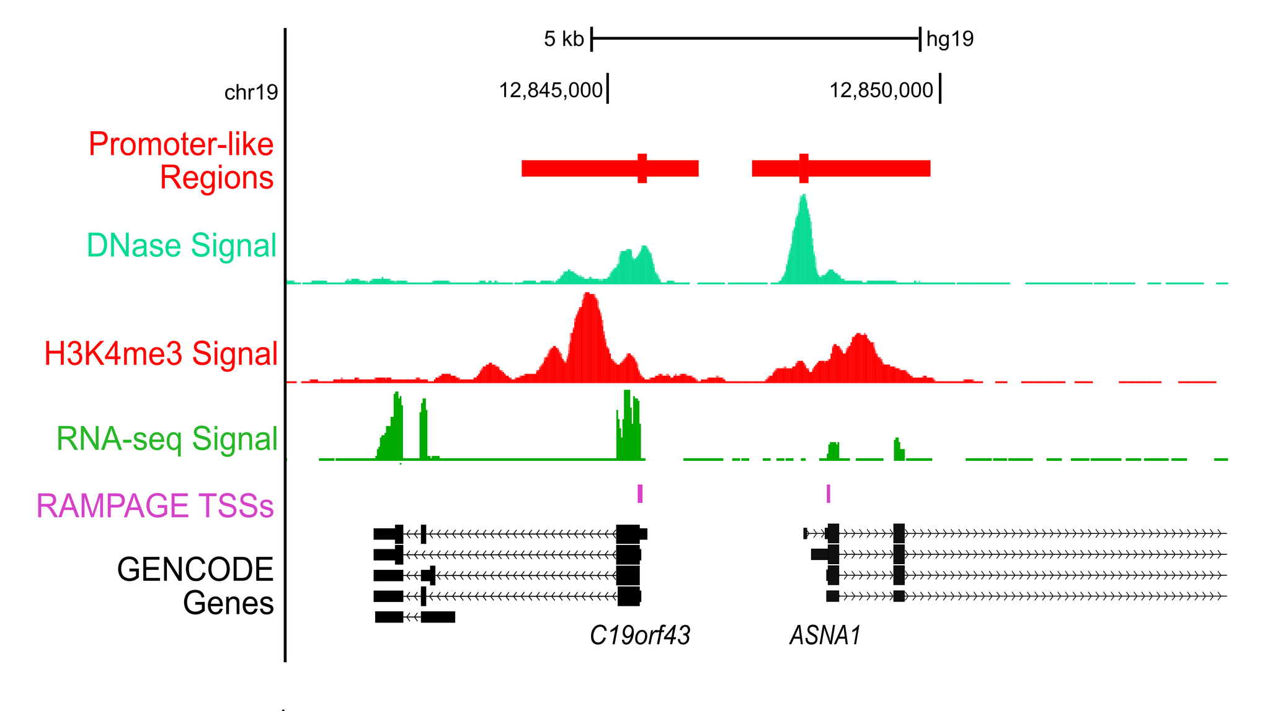
Visualization of Alignment

Slide 14
What is a genome annotation?
CTGCCGTCTGCTGCCATCGGAGCCCAAAGCCGGGCTGTGACTGCTCAGAC
CAGCCGGCTGGAGGGAGGGGCTCAGCAGGTCTGGCTTTGGCCCTGGGAGA
GCAGGTGGAAGATCAGGCAGGCCATCGCTGCCACAGAACCCAGTGGATTG
GCCTAGGTGGGATCTCTGAGCTCAACAAGCCCTCTCTGGGTGGTAGGTGC
AGAGACGGGAGGGGCAGAGCCGCAGGCACAGCCAAGAGGGCTGAAGAAAT
GGTAGAACGGAGCAGCTGGTGATGTGTGGGCCCACCGGCCCCAGGCTCCT
GTCTCCCCCCAGGTGTGTGGTGATGCCAGGCATGCCCTTCCCCAGCATCA
GGTCTCCAGAGCTGCAGAAGACGACGGCCGACTTGGATCACACTCTTGTG
AGTGTCCCCAGTGTTGCAGAGGTGAGAGGAGAGTAGACAGTGAGTGGGAG
TGGCGTCGCCCCTAGGGCTCTACGGGGCCGGCGTCTCCTGTCTCCTGGAG
AGGCTTCGATGCCCCTCCACACCCTCTTGATCTTCCCTGTGATGTCATCT
GGAGCCCTGCTGCTTGCGGTGGCCTATAAAGCCTCCTAGTCTGGCTCCAA
GGCCTGGCAGAGTCTTTCCCAGGGAAAGCTACAAGCAGCAAACAGTCTGC
ATGGGTCATCCCCTTCACTCCCAGCTCAGAGCCCAGGCCAGGGGCCCCCA
AGAAAGGCTCTGGTGGAGAACCTGTGCATGAAGGCTGTCAACCAGTCCAT
AGGCAAGCCTGGCTGCCTCCAGCTGGGTCGACAGACAGGGGCTGGAGAAG
GGGAGAAGAGGAAAGTGAGGTTGCCTGCCCTGTCTCCTACCTGAGGCTGA
GGAAGGAGAAGGGGATGCACTGTTGGGGAGGCAGCTGTAACTCAAAGCCT
TAGCCTCTGTTCCCACGAAGGCAGGGCCATCAGGCACCAAAGGGATTCTG
CCAGCATAGTGCTCCTGGACCAGTGATACACCCGGCACCCTGTCCTGGAC
ACGCTGTTGGCCTGGATCTGAGCCCTGGTGGAGGTCAAAGCCACCTTTGG
TTCTGCCATTGCTGCTGTGTGGAAGTTCACTCCTGCCTTTTCCTTTCCCT
AGAGCCTCCACCACCCCGAGATCACATTTCTCACTGCCTTTTGTCTGCCC
AGTTTCACCAGAAGTAGGCCTCTTCCTGACAGGCAGCTGCACCACTGCCT
GGCGCTGTGCCCTTCCTTTGCTCTGCCCGCTGGAGACGGTGTTTGTCATG

Slide 15
What is an annotation?
Gene
Repeat
Disease Locus
Something interesting
CTGCCGTCTGCTGCCATCGGAGCCCAAAGCCGGGCTGTGACTGCTCAGAC
CAGCCGGCTGGAGGGAGGGGCTCAGCAGGTCTGGCTTTGGCCCTGGGAGA
GCAGGTGGAAGATCAGGCAGGCCATCGCTGCCACAGAACCCAGTGGATTG
GCCTAGGTGGGATCTCTGAGCTCAACAAGCCCTCTCTGGGTGGTAGGTGC
AGAGACGGGAGGGGCAGAGCCGCAGGCACAGCCAAGAGGGCTGAAGAAAT
GGTAGAACGGAGCAGCTGGTGATGTGTGGGCCCACCGGCCCCAGGCTCCT
GTCTCCCCCCAGGTGTGTGGTGATGCCAGGCATGCCCTTCCCCAGCATCA
GGTCTCCAGAGCTGCAGAAGACGACGGCCGACTTGGATCACACTCTTGTG
AGTGTCCCCAGTGTTGCAGAGGTGAGAGGAGAGTAGACAGTGAGTGGGAG
TGGCGTCGCCCCTAGGGCTCTACGGGGCCGGCGTCTCCTGTCTCCTGGAG
AGGCTTCGATGCCCCTCCACACCCTCTTGATCTTCCCTGTGATGTCATCT
GGAGCCCTGCTGCTTGCGGTGGCCTATAAAGCCTCCTAGTCTGGCTCCAA
GGCCTGGCAGAGTCTTTCCCAGGGAAAGCTACAAGCAGCAAACAGTCTGC
ATGGGTCATCCCCTTCACTCCCAGCTCAGAGCCCAGGCCAGGGGCCCCCA
AGAAAGGCTCTGGTGGAGAACCTGTGCATGAAGGCTGTCAACCAGTCCAT
AGGCAAGCCTGGCTGCCTCCAGCTGGGTCGACAGACAGGGGCTGGAGAAG
GGGAGAAGAGGAAAGTGAGGTTGCCTGCCCTGTCTCCTACCTGAGGCTGA
GGAAGGAGAAGGGGATGCACTGTTGGGGAGGCAGCTGTAACTCAAAGCCT
TAGCCTCTGTTCCCACGAAGGCAGGGCCATCAGGCACCAAAGGGATTCTG
CCAGCATAGTGCTCCTGGACCAGTGATACACCCGGCACCCTGTCCTGGAC
ACGCTGTTGGCCTGGATCTGAGCCCTGGTGGAGGTCAAAGCCACCTTTGG
TTCTGCCATTGCTGCTGTGTGGAAGTTCACTCCTGCCTTTTCCTTTCCCT
AGAGCCTCCACCACCCCGAGATCACATTTCTCACTGCCTTTTGTCTGCCC
AGTTTCACCAGAAGTAGGCCTCTTCCTGACAGGCAGCTGCACCACTGCCT
GGCGCTGTGCCCTTCCTTTGCTCTGCCCGCTGGAGACGGTGTTTGTCATG

Slide 16
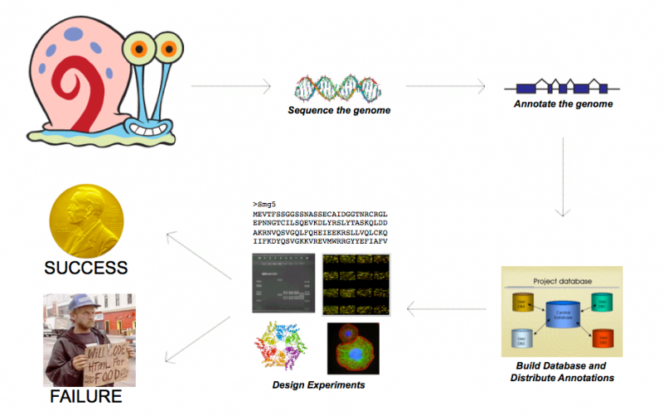
Why are genome annotations important?
Slide from Mark Yandell

Slide 17

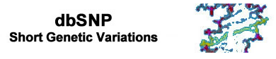








Annotations Provide Context
Conservation
Repeat elements
Genome Gaps
Cytobands
Gene annotations
“Mappability”
DeCIPHER
ISGA
Genetic variation
...CCTCATGCATGGAAA...
...CCTCATGTATGGAAA...
...CCTCATGCATGGAAA...
...CCTCATGCATGGAAA...
...CCTCATGTATGGAAA...
...CCTCATGCATGGAAA...
...CCTCATGTATGGAAA...
Chromatin marks
DNA methylation
RNA expression
TF binding

Slide 18
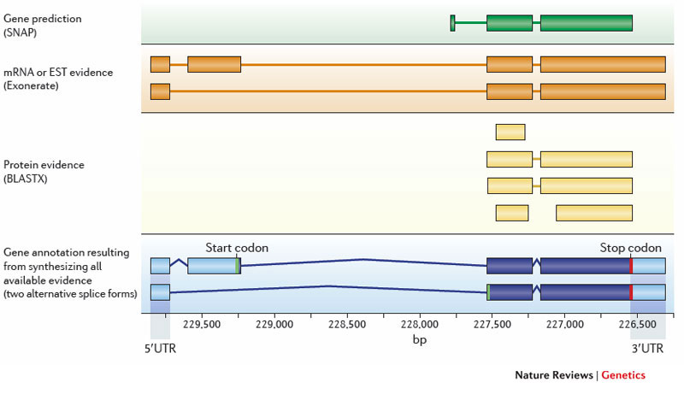
How do we annotate the genome?

Slide 19
The genome as coordinates
CAGTCGACATAGACTGATATGACACCACACTGAG...
chr3
1
5
10
15
20
25
30
35

Slide 20
How do you describe a gene?
chr3 5 10 geneA
CAGTCGACATAGACTGATATGACACCACACTGAG...
chr3
1
5
10
15
20
25
30
35

Slide 21
What about 2 consecutive genes?
chr3 19 30
Next Gene
CAGTCGACATAGACTGATATGACACCACACTGAG...
chr3
1
5
10
15
20
25
30
35

Slide 22
What about overlapping genes?
chr3 1 8 geneB
CAGTCGACATAGACTGATATGACACCACACTGAG...
chr3
1
5
10
15
20
25
30
35

Slide 23
File Formats
BED (Browser Extensible Format)
GFF (General Feature Format)
GTF (Gene Transfer Format, GTF2.2)

Slide 24
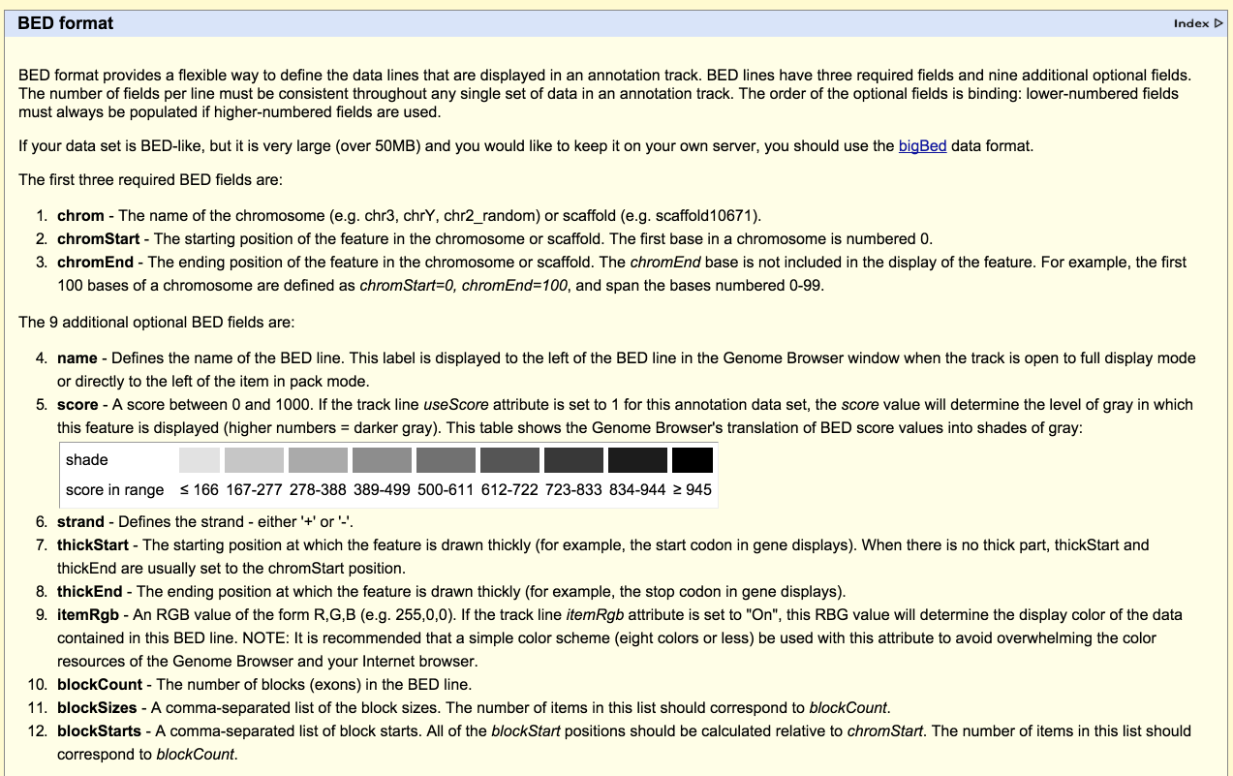
BED File Format

Slide 25
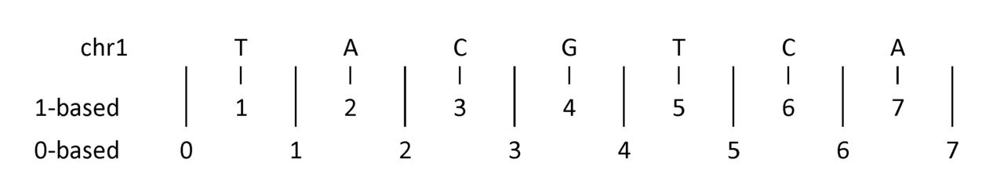
BED File use 0-based, half open intervals
chr1 1 3
https://www.biostars.org/p/84686/

Slide 26
Example BED3
CAGTCGACATAGACTGATATGACACCACACTGAG...
chr3
0
5
10
15
20
25
30
chr3 0 7
chr3 4 10
https://www.biostars.org/p/84686/

Slide 27
Add Name in 4th column to BED format
CAGTCGACATAGACTGATATGACACCACACTGAG...
chr3
0
5
10
15
20
25
30
chr3 0 7 first
chr3 4 10 second
https://www.biostars.org/p/84686/

Slide 28
Add Intensity in 5th column to BED format
CAGTCGACATAGACTGATATGACACCACACTGAG...
chr3
0
5
10
15
20
25
30
chr3 0 7 first 7.39
chr3 4 10 second 1e-8
https://www.biostars.org/p/84686/

Slide 29
Add orientation/strand to the 6th field
first
second
CAGTCGACATAGACTGATATGACACCACACTGAG...
chr3
0
5
10
15
20
25
30
chr3 0 7 first 7.39 +
chr3 4 10 second 1e-8 -
https://www.biostars.org/p/84686/

Slide 30
BED can also track Genome Annotations

Slide 31
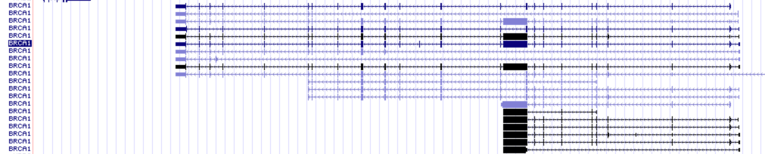
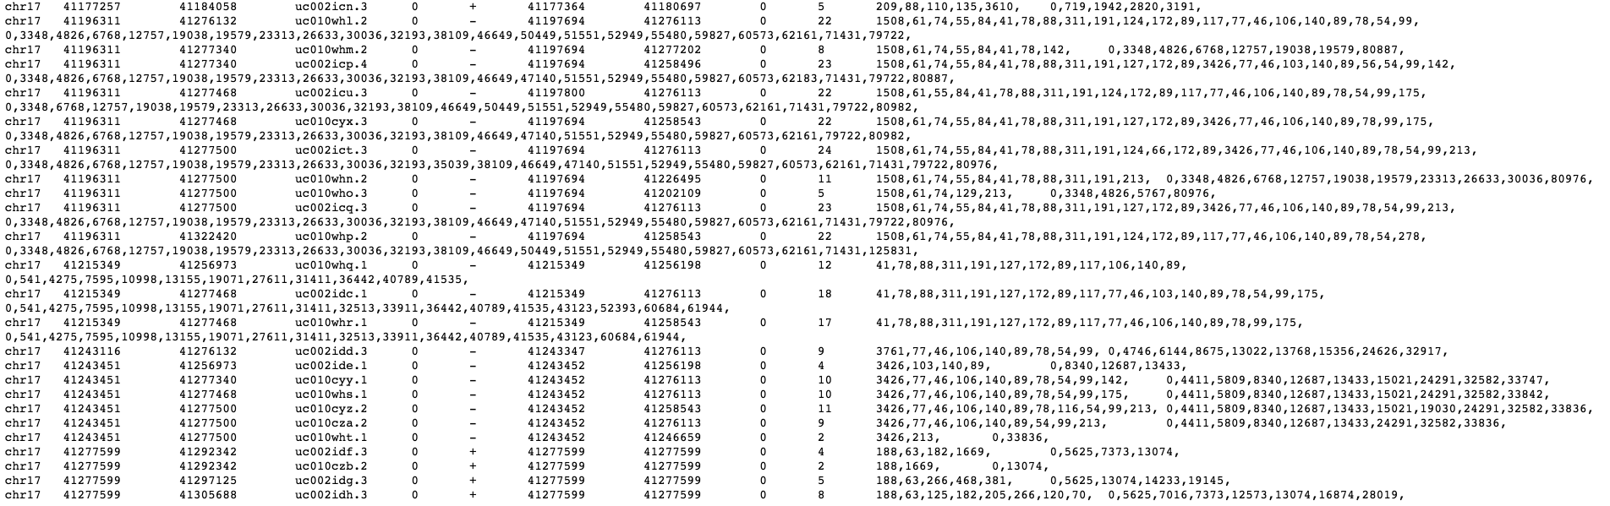
BED12 Example

Slide 32
GTF/GFF
Fields:
Seqname – name of chrom
Source – name of data source
Feature - type
Start – Start position
End – End position
Score
Strand
Frame – Indicates that base of codon
Attribute – Semicolon list
GFF (General Feature Format)
GTF (General Transfer Format)
Note: GFFv2 == GTF
chr22 TeleGene enhancer 10000000 10001000 500 + . touch1
chr22 TeleGene promoter 10010000 10010100 900 + . touch1
chr22 TeleGene promoter 10020000 10025000 800 - . touch2
Note that the start and end coordinates are 1-based versus 0-based BED format

Slide 33
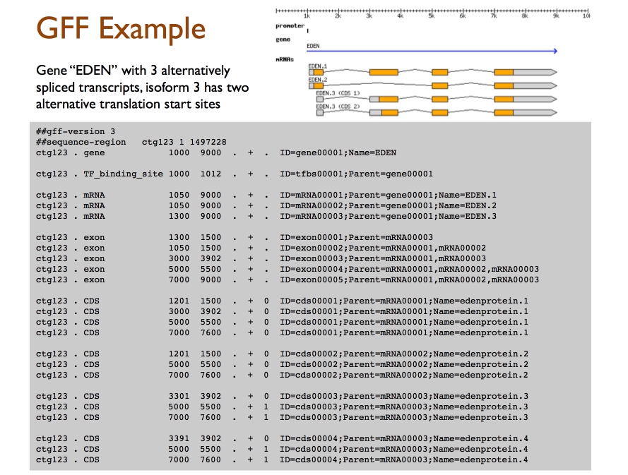
GTF/GFF Example

Slide 34
How does BED and GTF define a genomic range?
What interval defines the 2nd and 3rd nucleotides of chromosome 1?
https://www.biostars.org/p/84686/

Slide 35
How does BED and GTF define a genomic range?
What interval defines the 2nd and 3rd nucleotides of chromosome 1?
(BED) chr1 1 3
(GTF) chr1 2 3
https://www.biostars.org/p/84686/

Slide 36
Not all file formats are created Equal
BED: 0-based, half-open
GFF: 1-based, closed
SAM: 1-based, closed
BAM: 0-based, half-open.
VCF: 1-based, closed
…

Slide 37
Workshop: Logging onto BioHPC
Log onto VPN
Web browser: portal.biohpc.swmed.edu
Log onto BioHPC (top right)
Top menu: Cloud services -> Web Visualization
Launch a job and enter it

Slide 38
Workshop: Setup
Open a new terminal
(Applications -> System tools -> Terminal)
Copy examples folder:
cp –rp ../shared/gene_expr/rna_analysis .
Copy scripts and data

Slide 39
Exploring GTF files
Change directories:
cd gene_expr
See what’s in the directory
ls -lh
Change to annotation directory:
cd annotation

Slide 40
GENCODE Annotation
How many lines in the GTF file?
How would you view the first 5 lines of the file?
##description: evidence-based annotation of the mouse genome (GRCm38), version M10 (Ensembl 85)
##provider: GENCODE
##contact: gencode-help@sanger.ac.uk
##format: gtf
##date: 2016-07-19
Question: Why might this information be important?
wc -l gencode.gtf
head –n 5 gencode.gtf

Slide 41
GENCODE Annotation
Question: How many transcripts are there for Tnnt2?
(hint: use grep, cut, uniq 9th field (attributes) transcript ids have ENSMUST in transcript_id field semicolon ’;’ can be used as a delimiter)

Slide 42
Sequence Quality
4
5
2
PCR
duplicate removal
Create
Browser
tracks
6
Mapping
Visualize
fastq
bam
bam
bigwig
hisat2
picard
deeptools
IGV
3
1
Mapping Quality
fastqc
Sequence Quality
Fastqc
Report
Alignment
Stats
RNA reports

Slide 43
Check Sequence Quality
FastQC is a program that analyses some of the basic metrics on fastq raw read files:
Quality
Length
Sequence bias
GC content
Repeated sequences
Adapter contamination

Slide 44
Workshop: Sequence Quality
Open script1:
Applications -> Accessories -> Text Editor
Open -> Other documents
“Home” on the left panel
gene_expr -> rna_analysis -> scripts -> script1_fastqc.sh

Slide 45
The command: fastqc
Load the programs fastqc
module load fastqc
# make a directory to hold your raw alignments
mkdir sequence_quality
# mapping
fastqc -o [OUTDIR]\
[FASTQ FILE]
Make a new folder

Slide 46
The command: fastqc
module load fastqc
# make a directory to hold your raw alignments
mkdir sequence_quality
# mapping
fastqc -o sequence_quality\
../fastq/heart.e11.5.rep1.RNA-seq.fastq.gz

Slide 47
Workshop: Sequence quality (script1)
At the command prompt, type:
./script1_fastqc.sh
Example: E11.5 Rep1
You do: all the rest

Slide 48
Examining the output
Open a new results
(Applications -> Favorites-> Files)
Open
(gene_expr -> rna_analysis -> scripts -> sequence_analysis -> heart.e11.5.rep1.RNA-Seq_fastqc.html)

Slide 49
Mapping
4
5
2
PCR
duplicate removal
Create
Browser
tracks
6
Mapping
Visualize
fastq
bam
bam
bigwig
hisat2
picard
deeptools
IGV
3
1
Mapping Quality
fastqc
Sequence Quality
Fastqc
Report
Alignment
Stats
RNA reports

Slide 50
Workshop: Mapping
Open script2:
Applications -> Accessories -> Text Editor
Open -> Other documents
“Home” on the left panel
gene_expr -> rna_analysis -> scripts -> script2_mapping.sh

Slide 51
The command: hisat2
Load the programs hisat2 and samtools
module load hisat2
module load samtools
# Align data
hisat2 -p 32\
--add-chrname \
-S [OUTPUT FILE] \
-x [INDEX] \
--rna-strandnes F
-U [FASTQ FILE] \
--summary-file [OUTPUT FILE] –new-summary

Slide 52
The command: hisat2
Load the programs hisat2 and samtools
module load hisat2
module load samtools
# Align data
hisat2 -p 32\
--add-chrname \
-S heart_e11_5_rep1.sam \
-x /project/shared/bicf_workflow/GRC38/hisat2_index/genome\
--rna-strandnes F
-U ../fastq/heart.e11.5.rep1.RNA-seq.fastq.gz \
--summary-file heart_e11_5_rep1.alignSummary.txt –new-summary

Slide 53
Workshop: Mapping (script2)
At the command prompt, type:
./script2_mapping.sh
Example: E11.5
You do: Try P0

Slide 54
Examine the output
So far: you mapped E11.5
Your turn: Map the P0

Slide 55
Mapping Quality
4
5
2
PCR
duplicate removal
Create
Browser
tracks
6
Mapping
Visualize
fastq
bam
bam
bigwig
hisat2
picard
deeptools
IGV
3
1
Mapping Quality
fastqc
Sequence Quality
Fastqc
Report
Alignment
Stats
RNA reports

Slide 56
Examine the output
So far: you mapped E11.5 and P0
Question: How many reads mapped in each sample?

Slide 57
PCR duplicate removal
4
5
2
PCR
duplicate removal
Create
Browser
tracks
6
Mapping
Visualize
fastq
bam
bam
bigwig
hisat2
picard
deeptools
IGV
3
1
Mapping Quality
fastqc
Sequence Quality
Fastqc
Report
Alignment
Stats
RNA reports

Slide 58
What is PCR duplicate removal
RNA-seq uses PCR
Some fragments amplify better than others
Remove bias: if 2+ reads map to same place, then keep 1

Slide 59
Other options for RNA-seq
UMIs (Unique Molecular Identifers): should be used to prevent the removal of natural duplicates
https://bmcgenomics.biomedcentral.com/articles/10.1186/s12864-018-4933-1

Slide 60
The command: picard
Load the programs hisat2 and samtools
module load picard
module load samtools
# Align data
Java –j $PICARDJAR MarkDuplicates \
I=[BAM FILE] \
O=[OUTPUT FILE] \
M=[OUTPUT FILE]
REMOVE_DUPLICATES=true
Call picard to remove duplicates.

Slide 61
Workshop: Remove Duplicates
Open script3:
Applications -> Accessories -> Text Editor
Open -> Other documents
“Home” on the left panel
gene_expr -> rna_analysis -> scripts -> script3_dedup.sh

Slide 62
The command: picard
module load picard
module load samtools
# Align data
java –j $PICARDJAR MarkDuplicates \
I=../aligments/heart.p0.rep1.sorted.bam\
O=heart.p0.rep1.dedup.bam \
M=heart.p0.rep1.dedup.Metrics.txt
REMOVE_DUPLICATES=true

Slide 63
Try removing Replicates (script3)
So far: you mapped E11.5
Your turn: Map the P0

Slide 64
Workshop: Remove Duplicates (script3)
At the command prompt, type:
./script3_dedup.sh
Example: P0
You do: Try E11.5

Slide 65
Try removing Replicates (script3)
How many reads are mapped?
Compare with before PCR duplicate removal

Slide 66
Visualization
4
6
2
PCR
duplicate removal
Create
Browser
tracks
7
Mapping
Visualize
fastq
bam
bam
bigwig
hisat2
picard
deeptools
IGV
3
1
Mapping Quality
fastqc
Sequence Quality
Fastqc
Report
Alignment
Stats
RNA reports

Slide 67
Workshop: Visualization
Open script4:
Applications -> Accessories -> Text Editor
Open -> Other documents
“Home” on the left panel
gene_expr -> rna_analysis -> scripts -> script4_viz.sh

Slide 68
The command: bamCoverage
Load the programs deeptools
module load deeptools/2.5.0.1
# Calculate signal
bamCoverage –p 32\
-b [BAM FILE] \
-o [OUTPUT FILE]
Call bamCoverage to generate signal.

Slide 69
The command: bamCoverage
module load deeptools/2.5.0.1
# Calculate signal
bamCoverage –p 32\
-b ../../dedup/heart_e11_5.dedup.bam \
-o heart_e11_5.bw

Slide 70
Workshop: Visualization (script4)
At the command prompt, type:
./script4_viz.sh
Example: P0
You do: Try E11.5

Slide 71
Workshop: Lets see the data
Use Integrated Genome Viewer
module load IGV
igv.sh &
(1. load genome mm10 (top left))
(2. File -> Load from File (load bw files):
gene_expr/rna_analysis/browser_files)
(3. go to chr19)
(4). Autoscale tracks (right-click on track).

Slide 72
Mission accomplished: Morning
4
5
2
PCR
duplicate removal
Create
Browser
tracks
6
Mapping
Visualize
fastq
bam
bam
bigwig
hisat2
picard
deeptools
IGV
3
1
Mapping Quality
fastqc
Sequence Quality
Fastqc
Report
Alignment
Stats
RNA reports
Questions? Comments?

Slide 73
Overview of Afternoon
4
5
1
PCR
duplicate removal
Create
Browser
tracks
6
Mapping
Visualize
fastq
bam
bam
bigwig
hisat2
picard
deeptools
IGV
3
Annotations
(gtf)
2
Mapping Quality
fastqc
Sequence Quality
7
featureCounts
Fastqc
Report
Alignment
Stats
Quantification
9
Differential Analysis
Differential
Expressed
Genes
RNA reports
csv
deSeq2
8
multiqc
QC
report
html

Slide 74
Quantification
4
5
1
PCR
duplicate removal
Create
Browser
tracks
6
Mapping
Visualize
fastq
bam
bam
bigwig
hisat2
picard
deeptools
IGV
3
Annotations
(gtf)
2
Mapping Quality
fastqc
Sequence Quality
7
featureCounts
Fastqc
Report
Alignment
Stats
Quantification
9
Differential Analysis
Differential
Expressed
Genes
RNA reports
csv
deSeq2
8
multiqc
QC
report
html

Slide 75
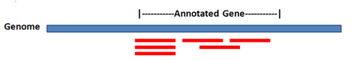
Gene/Transcript Quantification
The number of reads that align to each gene is an estimate of how many RNA transcripts were present in the sample for that gene.
Problems:
Paralogs (reads don't always map uniquely)
Reads that span 2 or more exons
Sampling error
http://michelebusby.tumblr.com/post/26913184737/thinking-about-designing-rna-seq-experiments-to

Slide 76
Raw Read Counts per Gene/Transcript
Gene | Control | Experimental Condition
Gene A | 27 | 27
Gene B | 90 | 270
Gene C | 280 | 640
Gene D | 1003 | 3021
Gene E | 3100 | 3342
Oooh! The experimental condition caused genes B,C,D, and E to be overexpressed!
Wow! Gene E is expressed at a 3X higher rate than Gene D!
FeatureCounts is a useful tool for generating counts: https://www.ncbi.nlm.nih.gov/pubmed/24227677

Slide 77
Raw Read Counts per Gene/Transcript
Gene | Control | Experimental Condition
Gene A | 27 | 27
Gene B | 90 | 270
Gene C | 280 | 640
Gene D | 1003 | 3021
Gene E | 3100 | 3342
Oooh! The experimental condition caused genes B,C, and D to be overexpressed!
Would you reach the same conclusion if you knew that the control experiment used 10 million reads while the experimental condition used 30 million reads?

Slide 78
Raw Read Counts per Gene/Transcript
Possible explanations:
3 times as many transcripts are expressed for Gene E than Gene D.
Gene E is 3X as long as Gene D.
Gene D and E are the same length and produce the same number of transcripts, but Gene D has a close paralog that has acted as a "sponge" for ⅔ of its alignments.
Gene | Control | Experimental Condition
Gene A | 27 | 27
Gene B | 90 | 270
Gene C | 280 | 640
Gene D | 1003 | 3021
Gene E | 3100 | 3342

Slide 79
Why we Normalize
To smooth out technical variations amoung samples:
Sequencing depth: genes have more reads in a deeper sequenced library
Gene length: longer genes are likely to have more reads that the shorter reads

Slide 80
Normalization
CPM (counts per million): counts scaled by total number of reads. This method accounts for sequencing depth only.
TPM (transcripts per kilobase million): counts per length of transcript (kb) per million reads mapped. This method accounts for both sequencing depth and gene length.
RPKM/FPKM (reads/fragments per kilobase of exon per million reads/fragments mapped): similar to TPM, as this method also accounts for both sequencing depth and gene length as well
Notes:
The measure RPKM (reads per kilobase of exon model per million reads) [1] is a within-sample normalization method that will remove the feature-length and library-size effects. This measure and its subsequent derivatives FPKM (fragments per kilobase of exon model per million mapped reads), a within-sample normalized transcript expression measure analogous to RPKs, and TPM (transcripts per million) are the most frequently reported RNA-seq gene expression values. It should be noted that RPKM and FPKM are equivalent for SE reads and that FPKM can be converted into TPM using a simple formula [38]. The dichotomy of within-sample and between-sample comparisons has led to a lot of confusion in the literature. Correcting for gene length is not necessary when comparing changes in gene expression within the same gene across samples, but it is necessary for correctly ranking gene expression levels within the sample to account for the fact that longer genes accumulate more reads. Furthermore, programs such as Cufflinks that estimate gene length from the data can find significant differences in gene length between samples that cannot be ignored. TPMs, which effectively normalize for the differences in composition of the transcripts in the denominator rather than simply dividing by the number of reads in the library, are considered more comparable between samples of different origins and composition but can still suffer some biases. These must be addressed with normalization techniques such as TMM

Slide 81
RPKM (or FPKM): reads per kilobase of exon model per million reads
Gene | Gene Size | Control | Experimental Condition
Gene A | 1 kb | 27 | 27
Gene B | 2 kb | 90 | 270
Gene C | 6 kb | 280 | 640
Gene D | 30 kb | 1003 | 3021
Gene E | 40 kb | 3100 | 3342
Notes:
The measure RPKM (reads per kilobase of exon model per million reads) [1] is a within-sample normalization method that will remove the feature-length and library-size effects. This measure and its subsequent derivatives FPKM (fragments per kilobase of exon model per million mapped reads), a within-sample normalized transcript expression measure analogous to RPKs, and TPM (transcripts per million) are the most frequently reported RNA-seq gene expression values. It should be noted that RPKM and FPKM are equivalent for SE reads and that FPKM can be converted into TPM using a simple formula [38]. The dichotomy of within-sample and between-sample comparisons has led to a lot of confusion in the literature. Correcting for gene length is not necessary when comparing changes in gene expression within the same gene across samples, but it is necessary for correctly ranking gene expression levels within the sample to account for the fact that longer genes accumulate more reads. Furthermore, programs such as Cufflinks that estimate gene length from the data can find significant differences in gene length between samples that cannot be ignored. TPMs, which effectively normalize for the differences in composition of the transcripts in the denominator rather than simply dividing by the number of reads in the library, are considered more comparable between samples of different origins and composition but can still suffer some biases. These must be addressed with normalization techniques such as TMM

Slide 82
RPKM (or FPKM): reads per kilobase of exon model per million reads
Gene | Gene Size | Control | Experimental Condition
Gene A | 1 kb | 27 | 27
Gene B | 2 kb | 90 | 270
Gene C | 6 kb | 280 | 640
Gene D | 30 kb | 1003 | 3021
Gene E | 40 kb | 3100 | 3342
Total (w/ counts for ~19000 other genes) |  | 20,000,000 | 40,000,000
Step 1: Normalize (i.e., adjust) gene counts by the total amount of sequences in the experiment
Notes:
The measure RPKM (reads per kilobase of exon model per million reads) [1] is a within-sample normalization method that will remove the feature-length and library-size effects. This measure and its subsequent derivatives FPKM (fragments per kilobase of exon model per million mapped reads), a within-sample normalized transcript expression measure analogous to RPKs, and TPM (transcripts per million) are the most frequently reported RNA-seq gene expression values. It should be noted that RPKM and FPKM are equivalent for SE reads and that FPKM can be converted into TPM using a simple formula [38]. The dichotomy of within-sample and between-sample comparisons has led to a lot of confusion in the literature. Correcting for gene length is not necessary when comparing changes in gene expression within the same gene across samples, but it is necessary for correctly ranking gene expression levels within the sample to account for the fact that longer genes accumulate more reads. Furthermore, programs such as Cufflinks that estimate gene length from the data can find significant differences in gene length between samples that cannot be ignored. TPMs, which effectively normalize for the differences in composition of the transcripts in the denominator rather than simply dividing by the number of reads in the library, are considered more comparable between samples of different origins and composition but can still suffer some biases. These must be addressed with normalization techniques such as TMM

Slide 83
RPKM (or FPKM): reads per kilobase of exon model per million reads
Gene | Gene Size | Control (RPM) | Experimental Condition (RPM)
Gene A | 1 kb | 1.34 | 0.675
Gene B | 2 kb | 4.5 | 6.75
Gene C | 6 kb | 14.0 | 16.0
Gene D | 30 kb | 50.15 | 75.525
Gene E | 40 kb | 155.0 | 83.55
Total |  | 20,000,000 | 40,000,000
Millions of reads |  | 20 | 40
Step 1: Normalize gene counts the total amount of sequences in the experiment
Notes:
The measure RPKM (reads per kilobase of exon model per million reads) [1] is a within-sample normalization method that will remove the feature-length and library-size effects. This measure and its subsequent derivatives FPKM (fragments per kilobase of exon model per million mapped reads), a within-sample normalized transcript expression measure analogous to RPKs, and TPM (transcripts per million) are the most frequently reported RNA-seq gene expression values. It should be noted that RPKM and FPKM are equivalent for SE reads and that FPKM can be converted into TPM using a simple formula [38]. The dichotomy of within-sample and between-sample comparisons has led to a lot of confusion in the literature. Correcting for gene length is not necessary when comparing changes in gene expression within the same gene across samples, but it is necessary for correctly ranking gene expression levels within the sample to account for the fact that longer genes accumulate more reads. Furthermore, programs such as Cufflinks that estimate gene length from the data can find significant differences in gene length between samples that cannot be ignored. TPMs, which effectively normalize for the differences in composition of the transcripts in the denominator rather than simply dividing by the number of reads in the library, are considered more comparable between samples of different origins and composition but can still suffer some biases. These must be addressed with normalization techniques such as TMM

Slide 84
RPKM (or FPKM): reads per kilobase of exon model per million reads
Gene | Gene Size | Control (RPM) | Experimental Condition (RPM)
Gene A | 1 kb | 1.34 | 0.675
Gene B | 2 kb | 4.5 | 6.75
Gene C | 6 kb | 14.0 | 16.0
Gene D | 30 kb | 50.15 | 75.525
Gene E | 40 kb | 155.0 | 83.55
Total |  | 20,000,000 | 40,000,000
Millions of reads |  | 20 | 40
Step 2: Normalize gene counts RPM by gene length
Notes:
The measure RPKM (reads per kilobase of exon model per million reads) [1] is a within-sample normalization method that will remove the feature-length and library-size effects. This measure and its subsequent derivatives FPKM (fragments per kilobase of exon model per million mapped reads), a within-sample normalized transcript expression measure analogous to RPKs, and TPM (transcripts per million) are the most frequently reported RNA-seq gene expression values. It should be noted that RPKM and FPKM are equivalent for SE reads and that FPKM can be converted into TPM using a simple formula [38]. The dichotomy of within-sample and between-sample comparisons has led to a lot of confusion in the literature. Correcting for gene length is not necessary when comparing changes in gene expression within the same gene across samples, but it is necessary for correctly ranking gene expression levels within the sample to account for the fact that longer genes accumulate more reads. Furthermore, programs such as Cufflinks that estimate gene length from the data can find significant differences in gene length between samples that cannot be ignored. TPMs, which effectively normalize for the differences in composition of the transcripts in the denominator rather than simply dividing by the number of reads in the library, are considered more comparable between samples of different origins and composition but can still suffer some biases. These must be addressed with normalization techniques such as TMM

Slide 85
RPKM (or FPKM): reads per kilobase of exon model per million reads
Gene | Gene Size | Control (RPKM) | Experimental Condition (RPKM)
Gene A | 1 kb | 1.34 | 0.675
Gene B | 2 kb | 2.25 | 3.375
Gene C | 6 kb | 2.33 | 2.67
Gene D | 30 kb | 1.67 | 2.52
Gene E | 40 kb | 3.875 | 2.09
Total |  | 20,000,000 | 40,000,000
Millions of reads |  | 20 | 40
Step 2: Normalize gene counts RPM by gene length
Notes:
The measure RPKM (reads per kilobase of exon model per million reads) [1] is a within-sample normalization method that will remove the feature-length and library-size effects. This measure and its subsequent derivatives FPKM (fragments per kilobase of exon model per million mapped reads), a within-sample normalized transcript expression measure analogous to RPKs, and TPM (transcripts per million) are the most frequently reported RNA-seq gene expression values. It should be noted that RPKM and FPKM are equivalent for SE reads and that FPKM can be converted into TPM using a simple formula [38]. The dichotomy of within-sample and between-sample comparisons has led to a lot of confusion in the literature. Correcting for gene length is not necessary when comparing changes in gene expression within the same gene across samples, but it is necessary for correctly ranking gene expression levels within the sample to account for the fact that longer genes accumulate more reads. Furthermore, programs such as Cufflinks that estimate gene length from the data can find significant differences in gene length between samples that cannot be ignored. TPMs, which effectively normalize for the differences in composition of the transcripts in the denominator rather than simply dividing by the number of reads in the library, are considered more comparable between samples of different origins and composition but can still suffer some biases. These must be addressed with normalization techniques such as TMM

Slide 86
Which Genes is most expressed in each condition
Gene | Gene Size | Control (RPKM) | Experimental Condition (RPKM)
Gene A | 1 kb | 1.34 | 0.675
Gene B | 2 kb | 2.25 | 3.375
Gene C | 6 kb | 2.33 | 2.67
Gene D | 30 kb | 1.67 | 2.52
Gene E | 40 kb | 3.875 | 2.09
Total |  | 20,000,000 | 40,000,000
Millions of reads |  | 20 | 40
RPKM is best for within-sample comparisons of gene expression. TPM is best for inter-sample comparisons
Notes:
The measure RPKM (reads per kilobase of exon model per million reads) [1] is a within-sample normalization method that will remove the feature-length and library-size effects. This measure and its subsequent derivatives FPKM (fragments per kilobase of exon model per million mapped reads), a within-sample normalized transcript expression measure analogous to RPKs, and TPM (transcripts per million) are the most frequently reported RNA-seq gene expression values. It should be noted that RPKM and FPKM are equivalent for SE reads and that FPKM can be converted into TPM using a simple formula [38]. The dichotomy of within-sample and between-sample comparisons has led to a lot of confusion in the literature. Correcting for gene length is not necessary when comparing changes in gene expression within the same gene across samples, but it is necessary for correctly ranking gene expression levels within the sample to account for the fact that longer genes accumulate more reads. Furthermore, programs such as Cufflinks that estimate gene length from the data can find significant differences in gene length between samples that cannot be ignored. TPMs, which effectively normalize for the differences in composition of the transcripts in the denominator rather than simply dividing by the number of reads in the library, are considered more comparable between samples of different origins and composition but can still suffer some biases. These must be addressed with normalization techniques such as TMM

Slide 87
Workshop: Quantification
Open script5:
Applications -> Accessories -> Text Editor
Open -> Other documents
“Home” on the left panel
gene_expr -> rna_analysis -> scripts -> script5_quant.sh

Slide 88
The command: featureCounts
Load the programs subread
module load subread
# make a directory to hold your counts
mkdir counts
# mapping
featureCounts –p –g gene_name \
-a ../../annotation/gencode.gtf
-o [OUT FILE]\
[BAM File]
Make a new folder

Slide 89
The command: featureCounts
module load subread
# make a directory to hold your counts
mkdir counts
# mapping
featureCounts –p –g gene_name \
-a ../../annotation/gencode.gtf \
-o heart_e11_5_rep1.cts \
../../dedup/heart_e11_5_rep1.deduped.bam

Slide 90
Workshop: Quantification (script5)
At the command prompt, type:
./script5_quant.sh
Example: E11.5 rep1
You do: Try rest

Slide 91
Workshop: Quantification
Look at results
head heart_e11_5_rep1.cts.summary
head heart_e11_5_rep1.cts
What are the counts for all the genes?
Tnnt2, Myh6, Myh7, Kcng2, Gja5

Slide 92
QC Report
4
5
1
PCR
duplicate removal
Create
Browser
tracks
6
Mapping
Visualize
fastq
bam
bam
bigwig
hisat2
picard
deeptools
IGV
3
Annotations
(gtf)
2
Mapping Quality
fastqc
Sequence Quality
7
featureCounts
Fastqc
Report
Alignment
Stats
Quantification
9
Differential Analysis
Differential
Expressed
Genes
RNA reports
csv
deSeq2
8
multiqc
QC
report
html

Slide 93
MultiQC – summary of QC stats

Slide 94
Workshop: Lets see summarize the QC
Use multiqc
module load multiqc
(1. multiqc .
(2. Open a new results
(Applications -> Favorites-> Files)
3) Open
(gene_expr -> rna_analysis -> scripts -> multiqc.html)

Slide 95
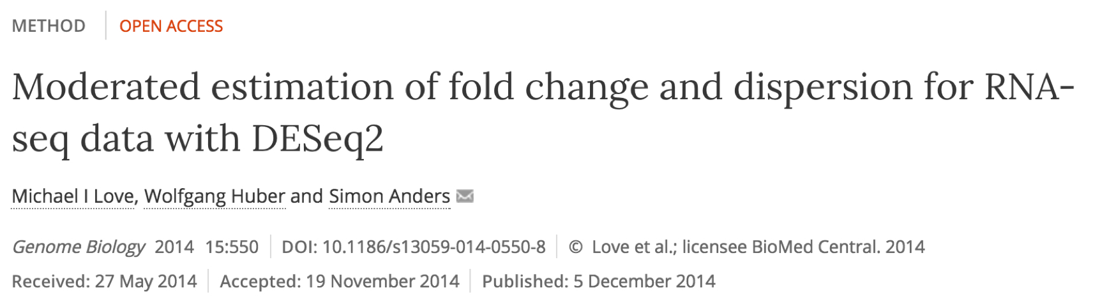

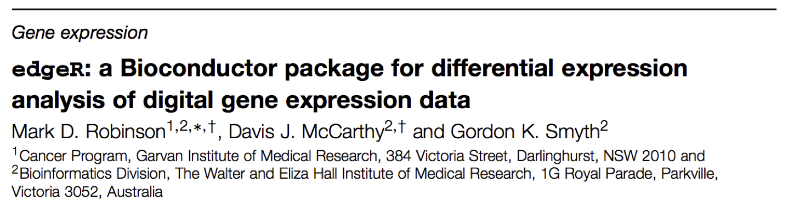
Differential Expression Between Samples
https://www.ncbi.nlm.nih.gov/pmc/articles/PMC4728800/pdf/13059_2016_Article_881.pdf

Slide 96


Why you need replicates?
A true technical replicate repeats sample and library prep.
Library prep sequencing
Technical replicate #1
Library prep sequencing
Technical replicate #2
Library prep sequencing
Biological replicate #1
Library prep sequencing
Biological replicate #1
http://michelebusby.tumblr.com/post/26913184737/thinking-about-designing-rna-seq-experiments-to

Slide 97
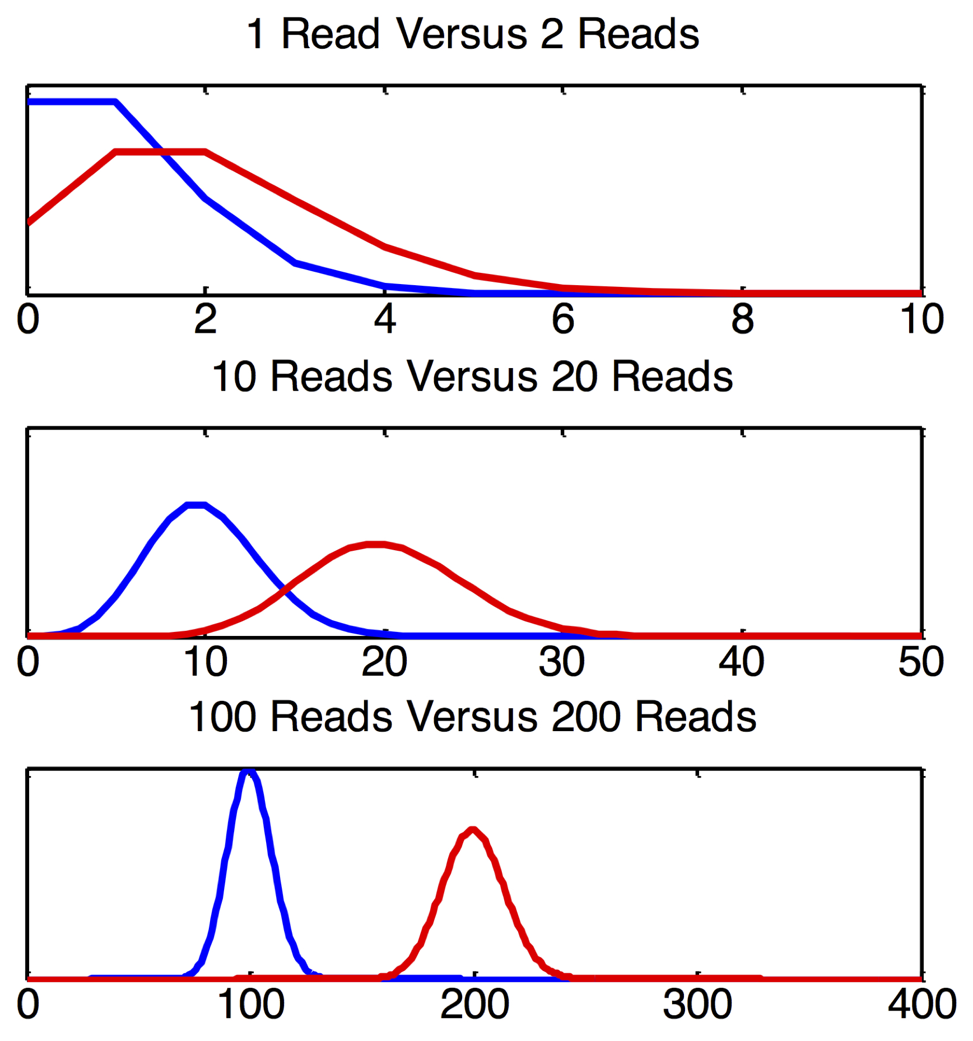
Source of Variation. Poisson (counting) noise
Gene A
Gene B
In each case, there is an apparent 2X difference in the mean read counts between control and experimental.
Yet poisson variance is higher relative to the total count when counts are low versus when they are high. For example, the difference in expression of a gene measured with one read versus two reads is inherently less certain than the differences in expression of a gene measured with 100 reads versus 200 reads, even though both differences are nominally a 2X fold change.
Gene C
http://michelebusby.tumblr.com/post/26913184737/thinking-about-designing-rna-seq-experiments-to

Slide 98
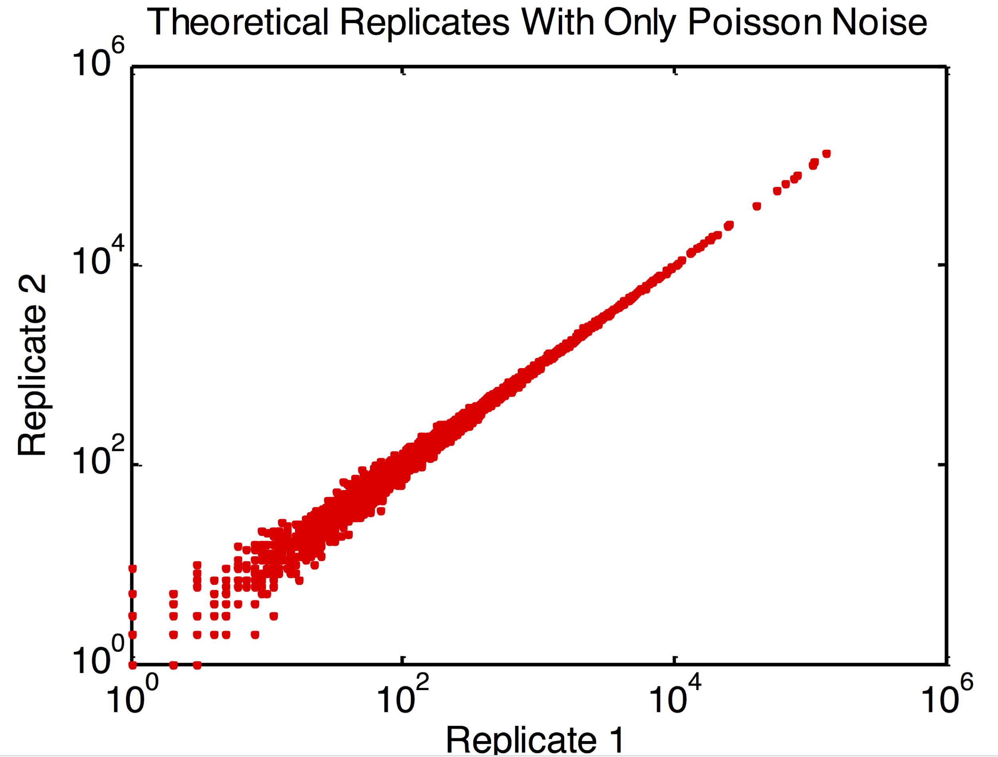
Source of Variation. Poisson (counting) noise
http://michelebusby.tumblr.com/post/26913184737/thinking-about-designing-rna-seq-experiments-to

Slide 99
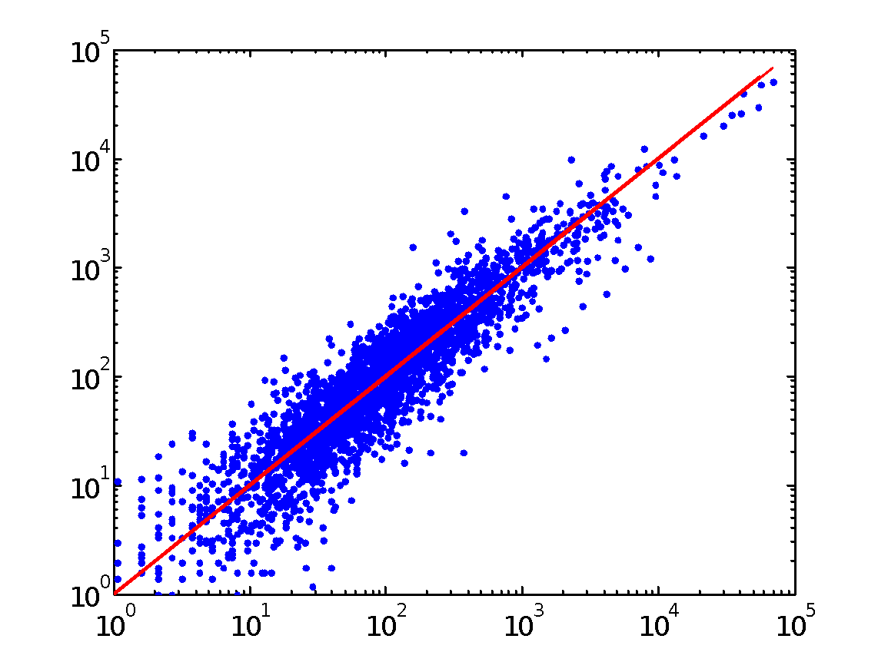
Source of Variation. Non-Poisson technical noise
"Non-Poisson Technical Variance is measurement imprecision that stems from the inability of RNA-Seq measurements to measure expression perfectly.
This imprecision is seen when expression from the same sample is measured twice. The expression measurements will not match exactly, and have error greater than what is expected from Poisson noise alone.
Sources of measurement imprecision may include PCR amplification errors during library preparation or machine errors."
-- Michele Busby
http://michelebusby.tumblr.com/post/26913184737/thinking-about-designing-rna-seq-experiments-to

Slide 100
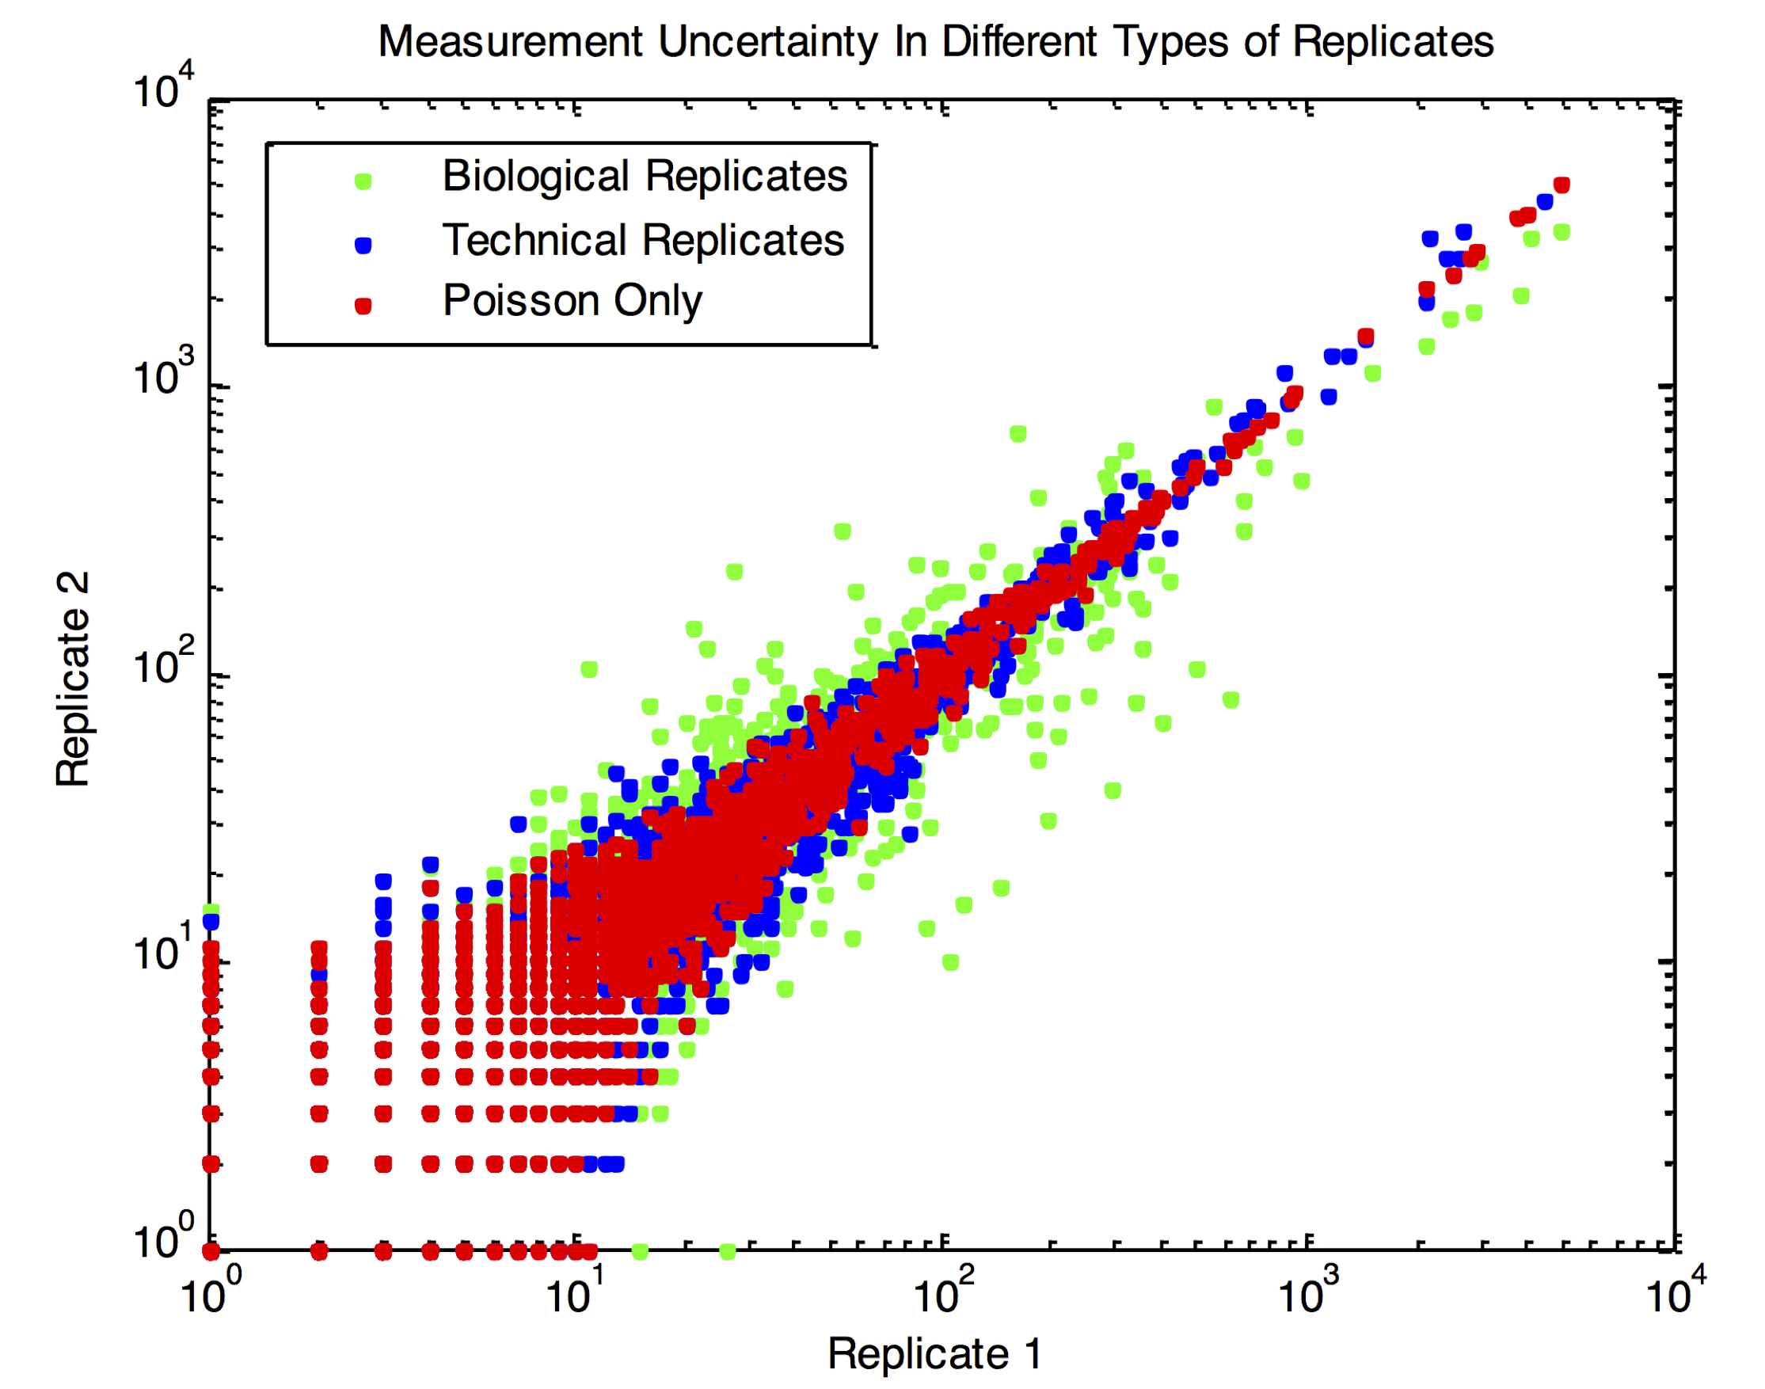
Sources of variance. Biological Variance
Biological variance is variance that naturally occurs within the samples under investigation. This variance stems from the fact that the expression of any given gene is likely to naturally fluctuate within the cells themselves, and between samples of the same condition. Sources of biological variance include genetic differences among samples and gene expression responses to the environment.
Green dots: biological replicates from S. cerevisiae
Blue dots: technical replicates from S. cerevisiae
Red dots: simulated replicates with only Poisson noise

Slide 101
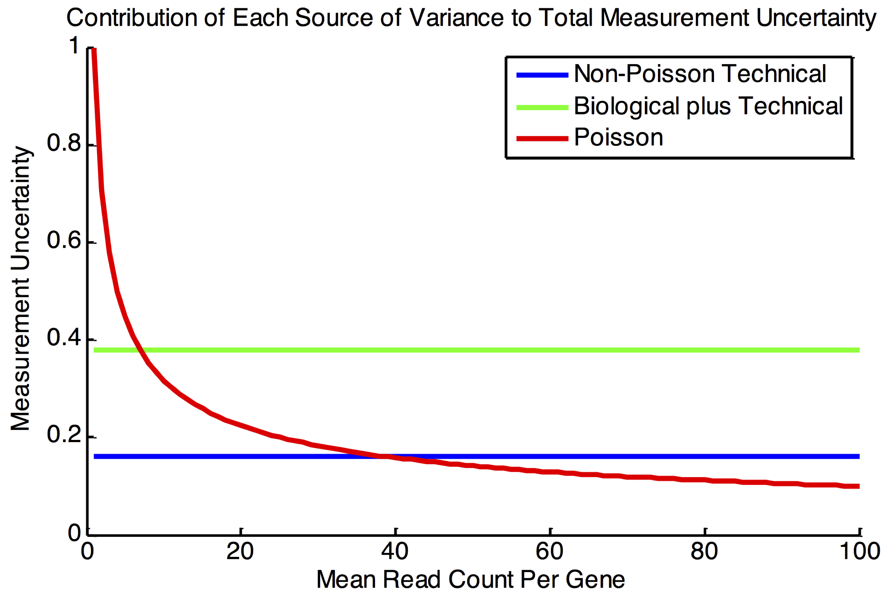
Relative contribution of sources of variance

Slide 102
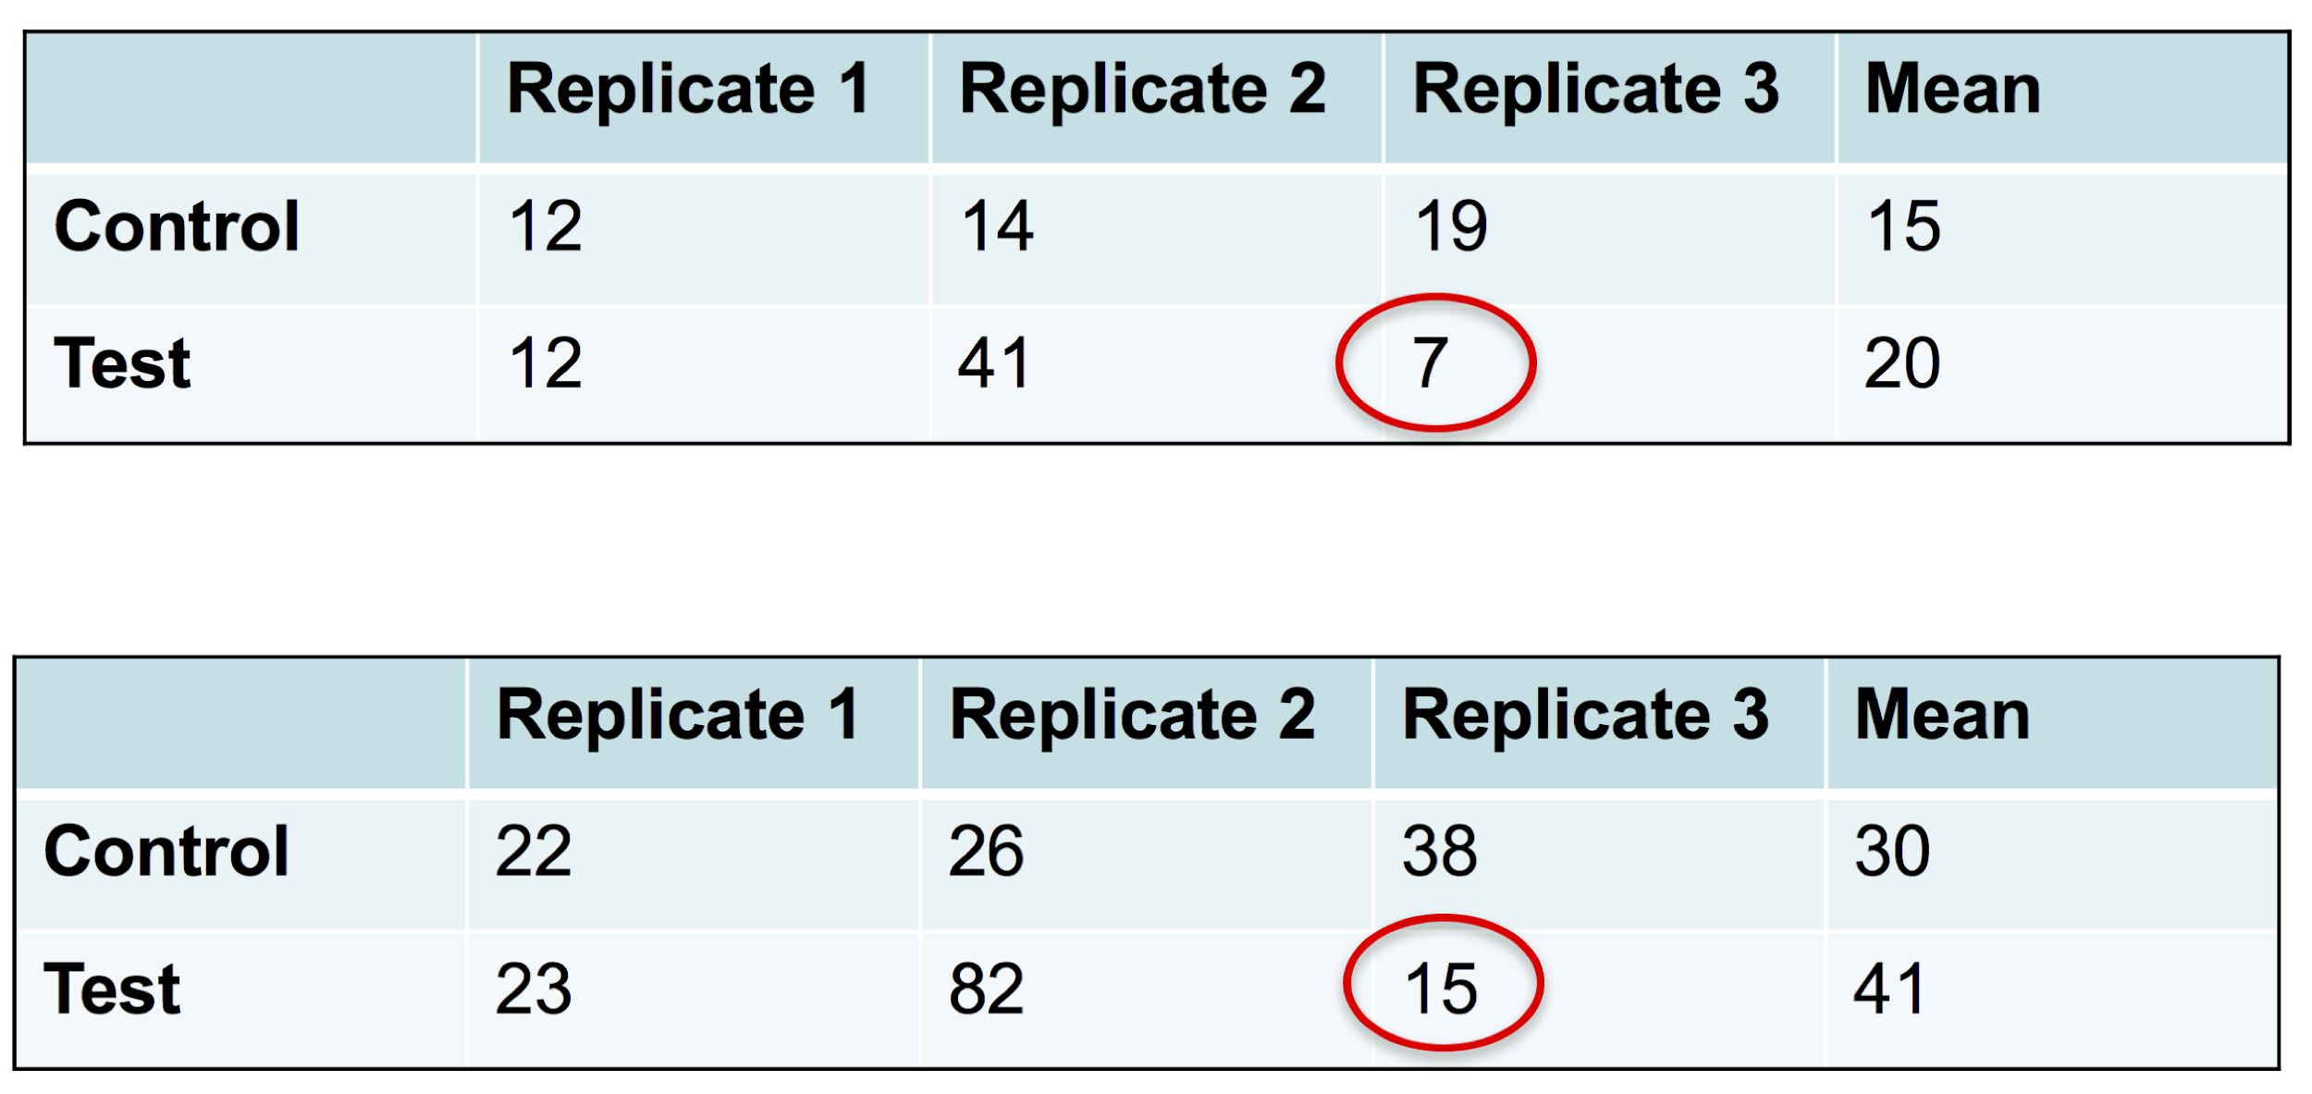
How to decrease uncertainty? Increase Reads
http://michelebusby.tumblr.com/post/26913184737/thinking-about-designing-rna-seq-experiments-to

Slide 103
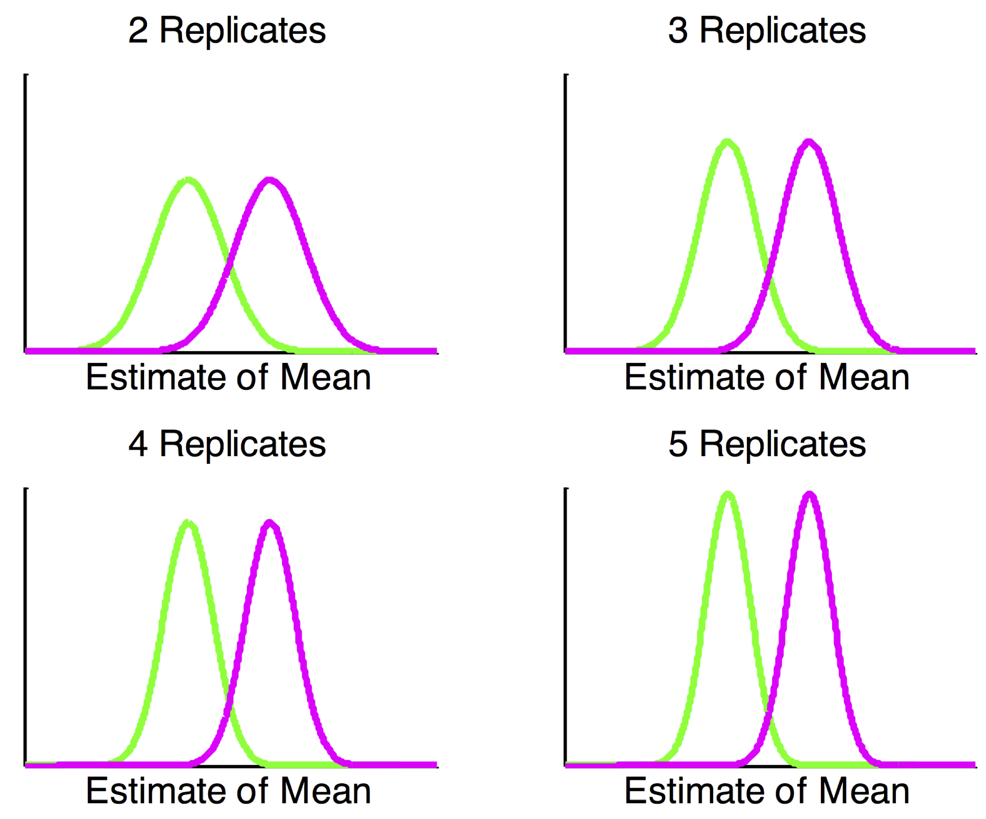
How to decrease uncertainty? Increase Replicates
http://michelebusby.tumblr.com/post/26913184737/thinking-about-designing-rna-seq-experiments-to

Slide 104
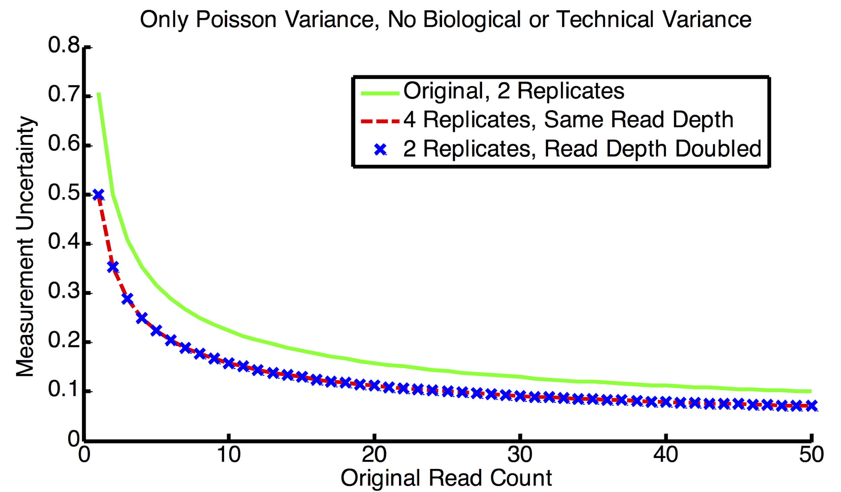
Which is better (Depth or Replicates)?
http://michelebusby.tumblr.com/post/26913184737/thinking-about-designing-rna-seq-experiments-to

Slide 105
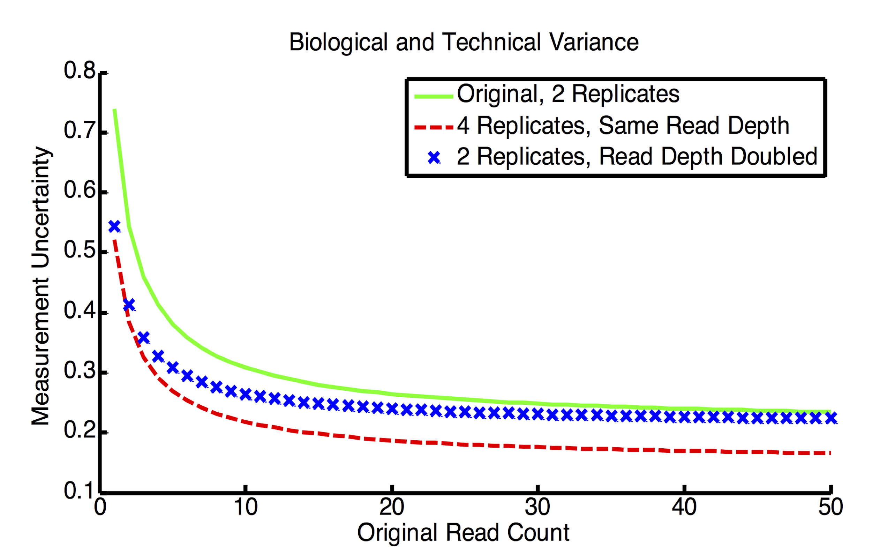
Which is better (Depth or Replicates)?
http://michelebusby.tumblr.com/post/26913184737/thinking-about-designing-rna-seq-experiments-to

Slide 106
Correcting for Multiple Testing
If you test 30,000 genes for differential gene expression, and you use a significance cut off of p<0.05, then you should expect to call approximately 1500 (i.e., 5% of 30000) genes to exhibit differential expressed solely random chance.
Thus, if your list of differentially expressed genes at p<0.05 is about 1500 genes long, then either there are no genes differentially expressed between the two conditions, or your experiment is underpowered.

Slide 107
False Discovery Rate
It is informative to report a False Discovery Rate (FDR) as well as a p-value. This value is the expected proportion of false positives among all of the significant results (100% in the previous example).
Usually we strive for a FDR at 5% or lower. Importantly, the FDR can only be calculated after an experiment is run, because it requires knowing how many genes were called differentially expressed.

Slide 108
QC Report
4
5
1
PCR
duplicate removal
Create
Browser
tracks
6
Mapping
Visualize
fastq
bam
bam
bigwig
hisat2
picard
deeptools
IGV
3
Annotations
(gtf)
2
Mapping Quality
fastqc
Sequence Quality
7
featureCounts
Fastqc
Report
Alignment
Stats
Quantification
9
Differential Analysis
Differential
Expressed
Genes
RNA reports
csv
deSeq2
8
multiqc
QC
report
html

Slide 109
Workshop: Differential Expression
Use R
Open gene_expression.md file

